Slide 1


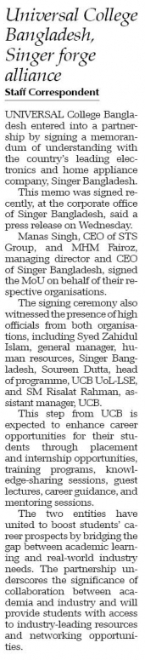
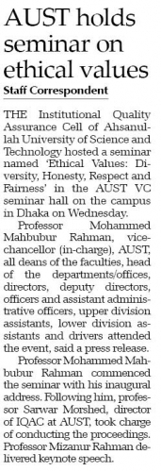
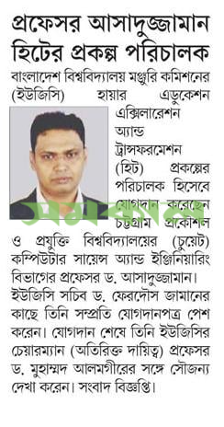
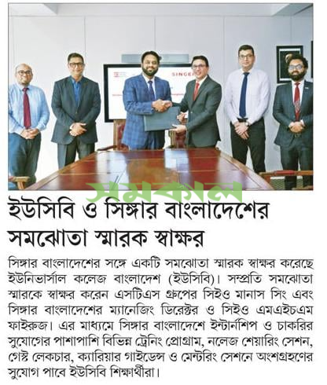
IUT LIBRARY
Daily News Clippings
Ref. No. LAS 2024.04.04
SOURCE: The daily NEW AGE on 04/04/2024 [both]
SOURCE: The daily SAMAKAL on 04/04/2024 [both]

Slide 2
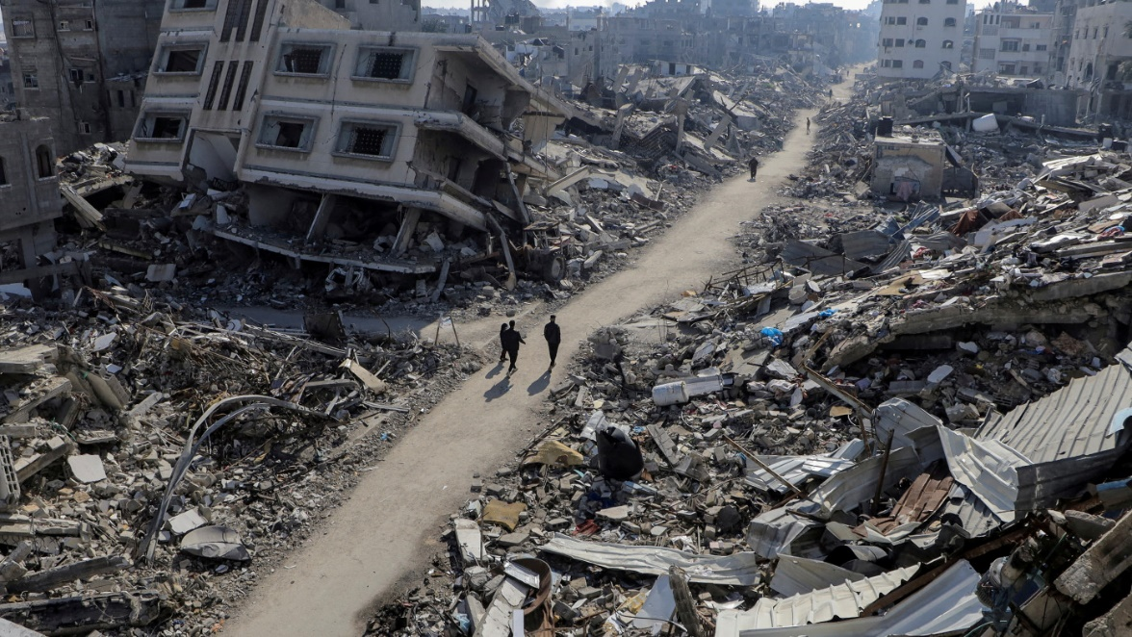
IUT LIBRARY
Daily News Clippings
Ref. No. LAS 2024.04.04
GENOCIDE IN PALESTINE
Palestinians should seek statehood through direct talks, not at UN, US says
The Palestinian Authority on Tuesday asked for renewed consideration of a 2011 application to become a full member of the United Nations
The United States said on Wednesday that establishing an independent Palestinian state should happen through direct negotiations between the parties and not at the United Nations.
The Palestinian Authority on Tuesday asked for renewed consideration of a 2011 application to become a full member of the United Nations. It currently has de facto recognition of the sovereign state of Palestine after the United Nations granted it the status of a non-member observer state in 2012.
The position of the US, Israel's most important ally, mirrors the Israeli stance on the issue.
An application to become a full UN member needs to be approved by the 15-member UN Security Council - where the United States can cast a veto - and then at least two-thirds of the 193-member General Assembly.
When asked if the US would use its Security Council veto to block the Palestinian bid, State Department spokesperson Matthew Miller said: "I'm not going to speculate about what may happen down the road."
But he added that the establishment of an independent Palestinian state with security guarantees for Israel "is something that should be done through direct negotiations between the parties - it's something we are pursuing at this time - and not at the United Nations."
The Palestinian push for full UN membership comes as the war between Israel and Palestinian Hamas militants in Gaza nears a six-month milestone and Israel is expanding settlements in the occupied West Bank.
Malta is president of the Security Council for April. Malta's UN Ambassador Vanessa Frazier said on Wednesday that the Palestinian request had been circulated to council members.
"We will be consulting with each member to consider the appropriate way forward," she told reporters.
Palestinian UN envoy Riyad Mansour told Reuters on Monday that the aim was for the Security Council to take a decision at an 18 April ministerial meeting on the Middle East, but that a vote had yet to be scheduled.
Little progress has been made on achieving Palestinian statehood since the signing of the Oslo Accords between Israel and the Palestinian Authority in the early 1990s.
SOURCE: The daily BUSINESS STANDARD on 04/04/2024
Compiled by: AKM Habibur Rahman (Sr. Cataloguer)
Copy to:
1) PS to the Vice-Chancellor for kind information of the Vice-Chancellor.
2) Preserve, Library Archive Section.

